Slide 2

12. Technologies you plan to use

Slide 3
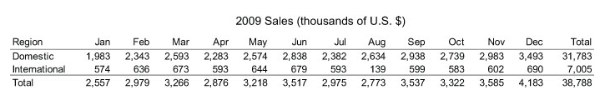
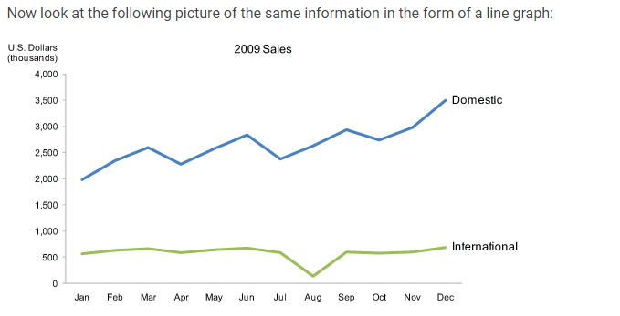
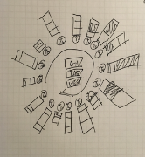
13. How to design, build and evaluate?
Design – A picture is worth a thousand words - but only when the story is best told graphically rather than verbally and the picture is well designed.
Notes:
Choosing the best design that represents the data will be the key design strategy.
Figure 13.1
This table does two things extremely well: it expresses these sales values precisely and it provides an efficient means to look up values for a particular region and month. But if we're looking for patterns, trends, or exceptions among these values, if we want a quick sense of the story contained in these numbers, or we need to compare whole sets of numbers rather than just two at a time, this table fails.
Figure 13.2
Several facts now leap into view:
Domestic sales were considerably and consistently higher than international.
Domestic sales trended upward over the year as a whole.
International sales, in contrast, remained relatively flat, with one glaring exception: they decreased sharply in August.
Domestic sales exhibited a cyclical pattern - up, up, down - that repeated itself on a quarterly basis, always reaching the peak in the last month of the quarter and then declining dramatically in the first month of the next.
What these numbers could not communicate when presented as text in a table, which our brains interpret through the use of verbal processing, becomes visible and understandable when communicated visually. This is the power of "data visualization."
https://www.interaction-design.org/literature/book/the-encyclopedia-of-human-computer-interaction-2nd-ed/data-visualization-for-human-perception

Slide 4
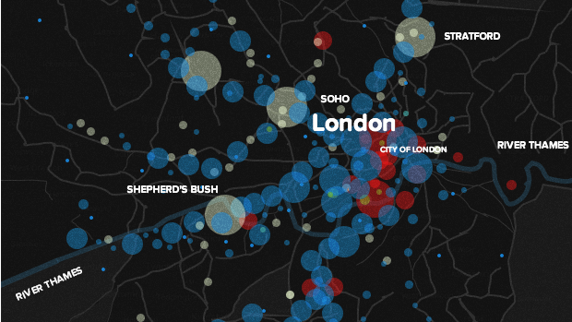
using D3 to build beautiful web maps
Notes:
Design goal : Create an experience which allows users to be able to play around and explore the employment statisitcs and dig out meaningful information that best suits their interest.

Slide 5
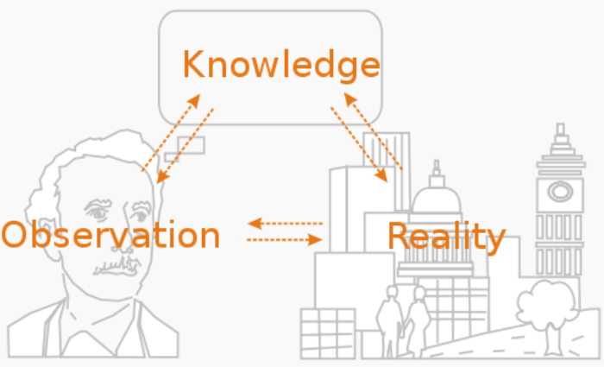
Evaluate
Notes:
Evaluation methodologies:
Observation
Focus Groups – evaluation team
Controlled experiments

Slide 6
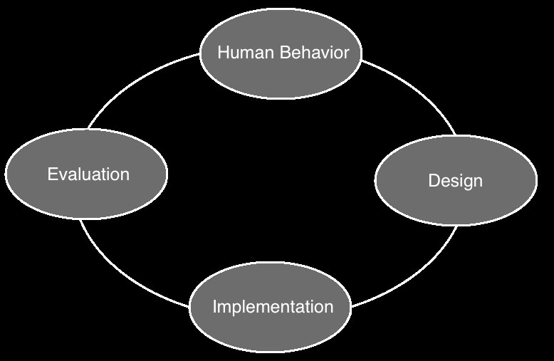

Slide 7
14. Deliverables?

Slide 8
a fully interactive visualization project covering multiple coordinated views representing different aspects of Occupational Employment Statistics.
a fully functional prototype demonstrating key features, and a process book documenting each steps as well.

Slide 9

15. How do you work together?

Slide 10
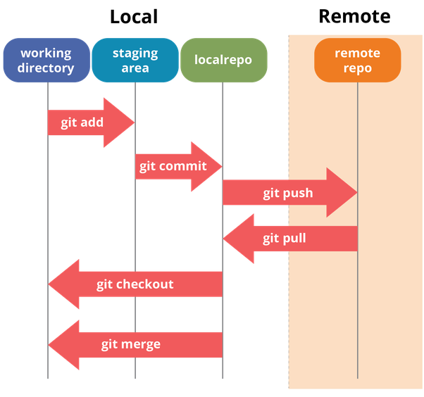


Slide 11

Timeline

Slide 12
Data collection
Comprehend data
Data cleaning to extract meaningful features
Pen and paper models
Complete prototype
D3 visualizations

